Slide 1
DATA 604 Final Project Bank Teller Simulation
Sie Siong Wong
2022 Summer

Slide 2
Problem Statement
How is changing the number of bank tellers might affect the waiting time for clients.
Bank executives don't want to hire too many tellers, and too little tellers that can cause customers to wait in line too long which cause customer dissatisfaction.
This goal of developing this simulation program is to help bank executives to determine an optimal number of tellers they want to hire for

Slide 3
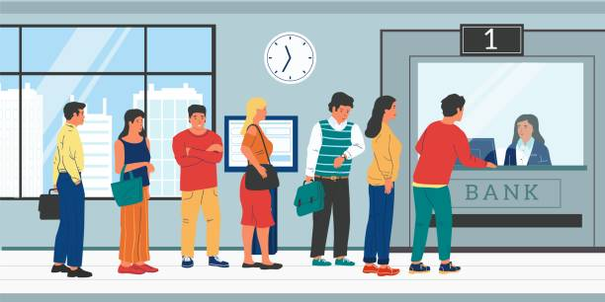

Slide 4
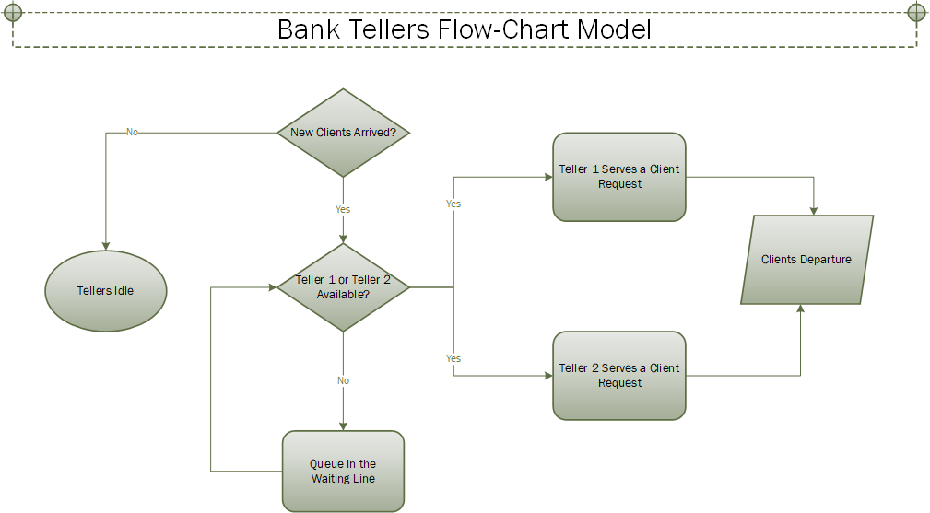

Slide 5
Simulation Codes
The libraries that I use to develop this simulation program is as below.
- simpy
- random
- numpy
- modsim
The simulation program was built mainly based on the simpy. I use other libraries in additional to the simpy because of some functions. For example, random library has the randomized exponential distribution function which is a critical function for generating client arrival time.

Slide 6
Simulation Codes Cont.
There are 3 functions with parameters built into this simulation.
client_generator(env, mean_inter_arrival_time, mean_serve_time, teller)
activity_generator(env, mean_serve_time, teller, c_id)
run_simulation(capacity, arrival_time, serve_time)
The details of these functions are showing in the following slides.

Slide 7
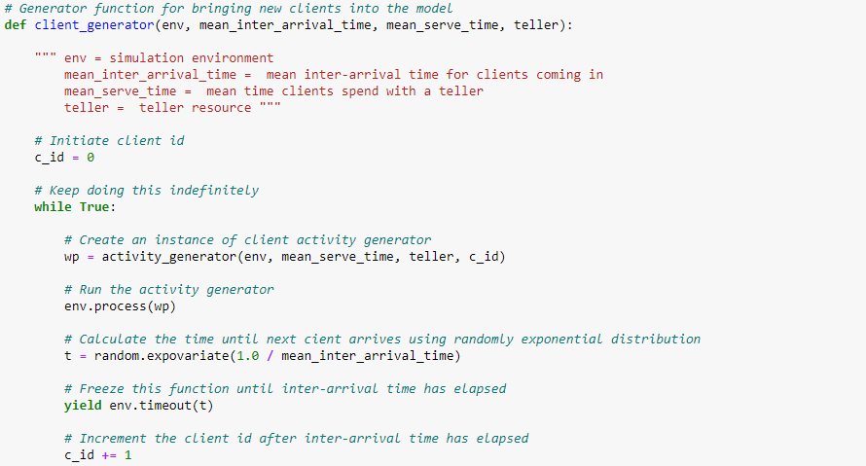
Simulation Codes Cont.

Slide 8
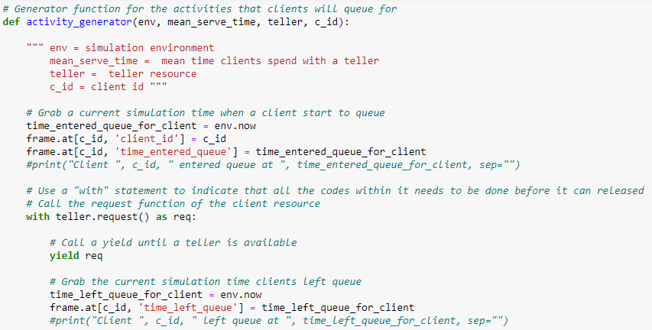
Simulation Codes Cont.

Slide 9
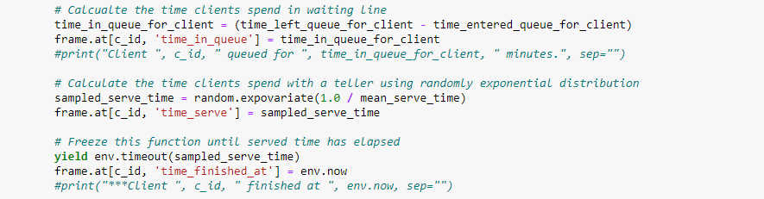
Simulation Codes Cont.

Slide 10
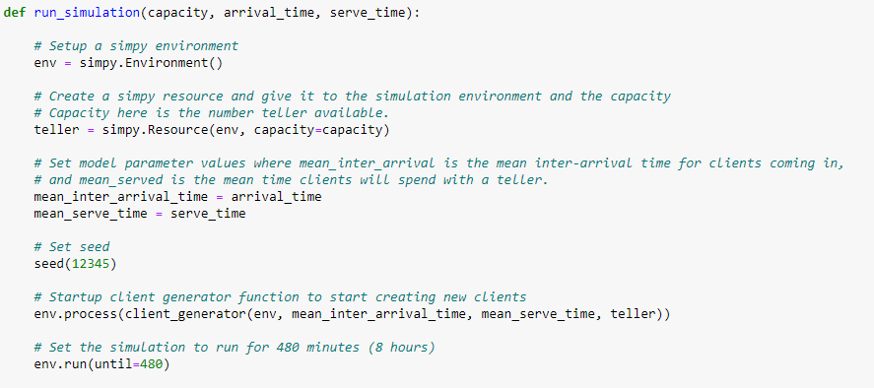
Simulation Codes Cont.

Slide 11
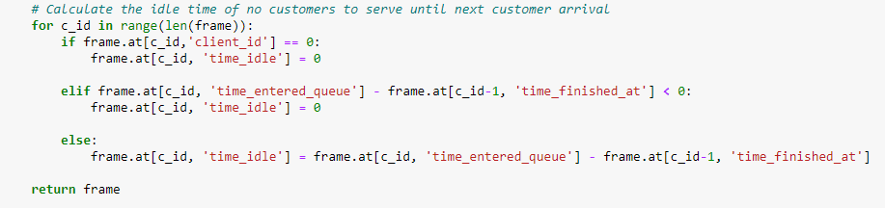
Simulation Codes Cont.

Slide 12
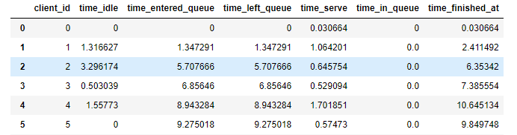
Results
Below is a dataframe return from run simulation function:
E.g. Client 0 arrived at the bank without queueing and went straight to the counter and left bank at 0.030664 minutes. All tellers have been idled for 1.316627 minutes until the second client (id=1) arrived at the bank at 1.347291 minutes.

Slide 13
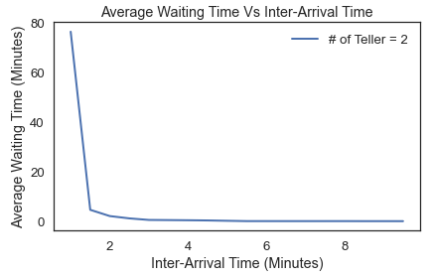
Results Cont.
Average waiting time vs. variation of mean inter-arrival time.
Average waiting time dropped sharply when the gap of client arrival time is at 1.5 minute.

Slide 14
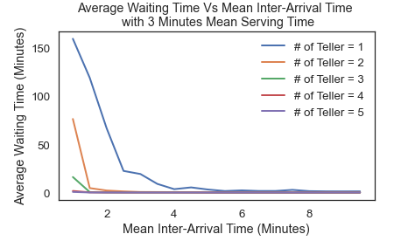
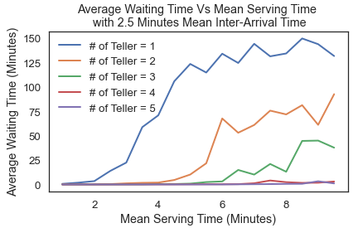
Results Cont.
Let’s see how the average waiting time changes for different number of tellers in place with variation of mean inter-arrival time and mean serving time.

Slide 15
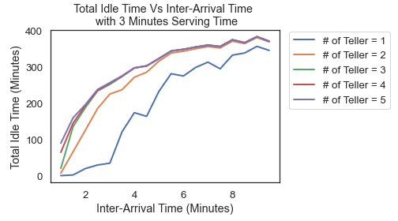
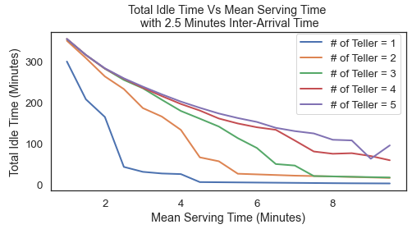
Results Cont.
Now, let’s see how the total idle time changes for different number of tellers in place with variation of mean inter-arrival time and mean serving time.

Slide 16
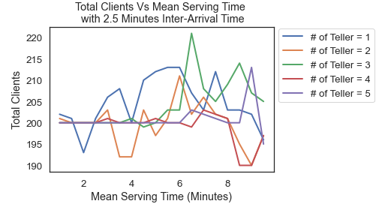
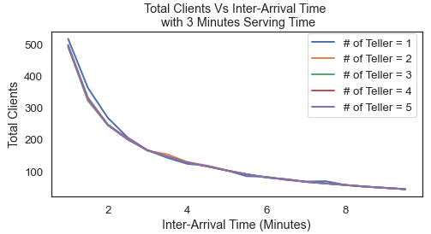
Results Cont.
Finally, let’s see how the total number of clients changes for different number of tellers in place with variation of mean inter-arrival time and mean serving time.

Slide 17
Verification and Validation
2 tellers is the optimal number of tellers to hire to meeting the goal of average waiting time at 3 minutes or less.
According to this similar simulation article (Hammond and Mahesh 1995) , majority of the banks has a desired policy to provide service for their clients within 3 minutes.
In the article, it also mentioned that "The two tellers calculated to be adequate 95 % of the time under average conditions provided the desired level of service only 68 % of the time in the simulation model.“
The optimal parameter values indicated from the simulation results above are 3 minutes of mean inter-arrival time and 5.5 minutes of serving as shown in below.

Slide 18
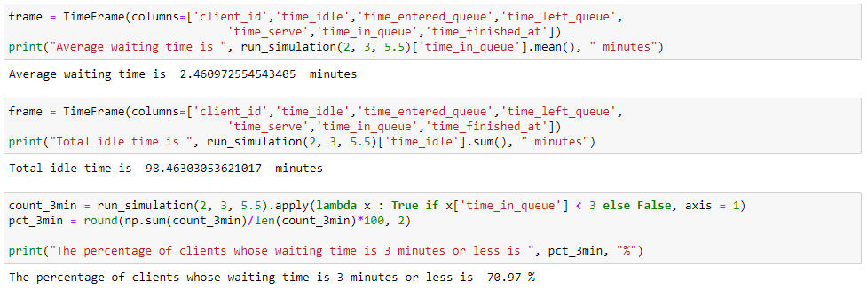
Verification and Validation Cont.
Below calculation results verify and justify the validity of the simulation model.

Slide 19
Conclusions
This bank teller simulation study has demonstrated that bank executives can use this simulation program to figure out the optimal number of tellers based on the mean inter-arrival time and the mean serving time for a client.
The number of clients coming in every working day looking for tellers vary greatly across different regions and communities. For example, the bank located in high population density areas like Manhattan will require much more tellers.
It requires executives to have a good estimate of mean inter-arrival time and mean serving time in order to use this simulation program to find out the optimal number of tellers.

Slide 20


